Slide 1

Lincoln Park High School
Michele Blankenberger
Meghan Huffman
Joe Jemison
Amber Larson
Paige Narr
Gretchen Selzer

Slide 2
School Profile

Slide 3
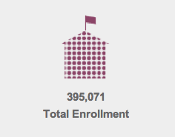
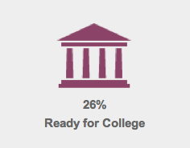
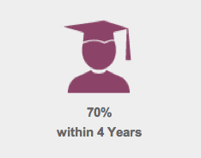
Lincoln Park High School
2001 N Orchard Street, Chicago, IL 60614
City of Chicago School District 299
  Illinois Report Card Fast Facts about District 299
Notes:
395,071 students enrolled in this district
26% of students who achieved a combined score of at least 21 on the ACT
70% of students graduated within 4 years, adjusted for mobility

Slide 4
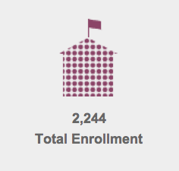
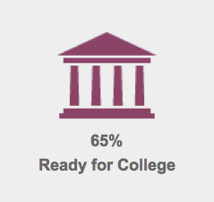
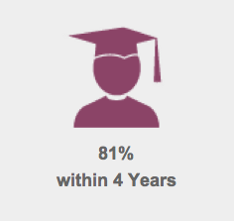
Lincoln Park High School
Illinois Report Card Fast Facts about LPHS

Slide 5
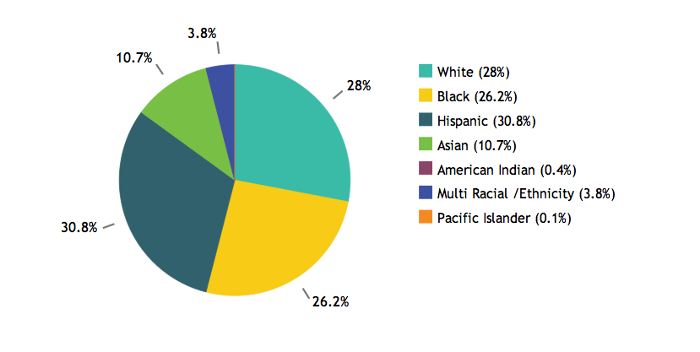
Lincoln Park High School
Illinois Report Card Racial/Ethnic Diversity

Slide 6
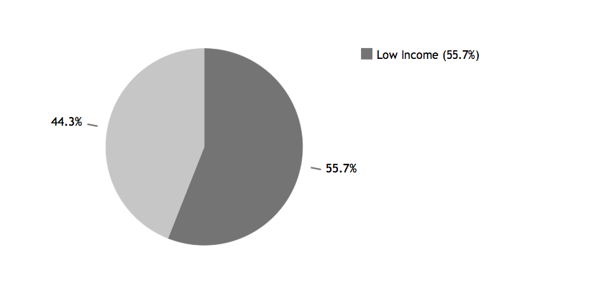
Lincoln Park High School
Illinois Report Card Low Income

Slide 7
Lincoln Park High School
Illinois Report Card Adequate Yearly Progress (AYP) Report 2013
  Is this school making AYP?
  Is this school making AYP in reading and math?
  Has this school been identified for School Improvement according to the AYP specifications of the federal No Child Left Behind Act?
  2013-2014 State Improvement Status: Academic Watch Status Year 8
Notes:
Adequate Yearly Progress (AYP) is a measurement defined by the United States federal No Child Left Behind Act that allows the U.S. Department of Education to determine how every public school and school district in the country is performing academically according to results on standardized tests. How schools are held accountable.
AYP is based on three factors: the percentage of students who meet or exceed the standards in math and reading; the percentage of students participating in the ISAT, PSAE, or IAA assessments; and the attendance rate at the elementary/middle schools or the graduation rate at the high school level.
This display indicates whether or not the school has made Adequate Yearly Progress (AYP).
AYP represents the annual academic performance targets in reading and math that the State, school districts, and schools must reach to be considered on track for 100% proficiency by school year 2013-14.
One of the reasons why LPHS has been on probation the past 8 years is because some of their students are not meeting the reading and math standards, which impacts the school’s overall rating. In particular, there has been a trend of African-American students not meeting these standards which was one of the reasons why Chris originally wanted us to focus on this population.

Slide 8
Lincoln Park High School
Academic Programs & History
  Ranked #2 in Performance Arts in Illinois
  Rated #11 high school in Illinois in 2013
  Average ACT composite score of 22.3 in 2011 and increasing
  International Baccalaureate (IB) program among top 10% worldwide since 1984
  Offers over 20 Advanced Placement (AP) courses
Notes:
Over the past 25 years, Lincoln Park High school has received honors in city competition in both vocal and instrumental music. Ranked 2nd in Music in the state in Class AA for 4th consecutive year.
Rated #11 high school in IL by US News an World Report (2013)
ACT composite score of 22.3 (2012) and increased from 21.6 in 2011.
IB program is among the top 10% world wide and since 1984, approx. 87% of LP IB students have earned full IB diploma (I don’t know what that means exactly)
Offers over 20 AP courses

Slide 9
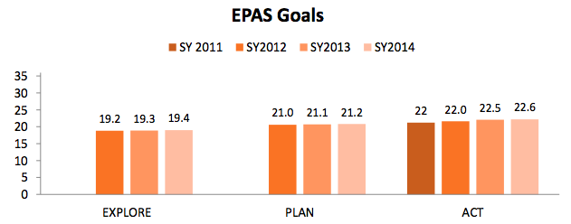
Lincoln Park High School
School Improvement Goals
  Educational Planning and Assessment System (EPAS) Goals
Notes:
ACT most widely used
Explore ACT and Plan ACT discontinued this year… Now Aspire ACT is used

Slide 10
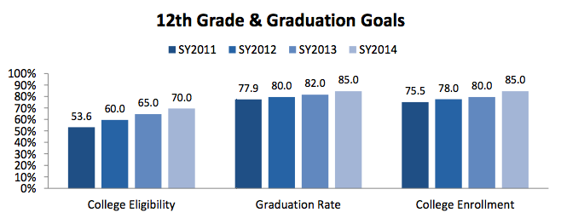
Lincoln Park High School
School Improvement Goals
  12th Grade & Graduation Goals

Slide 11
Lincoln Park High School
Counseling Department
  Eight total counselors
  One College & Career Coach
  One Social Worker
  Chris Baker – Freshmen Counselor
  Jessica Hubbell – General School Counselor
Counseling Department Website
  Freshman, Sophomore, Junior, Senior Bulletins
  Additional resources available
Notes:
FAFSA information, college match information, college visit schedule etc.

Slide 12
Community Mapping

Slide 13
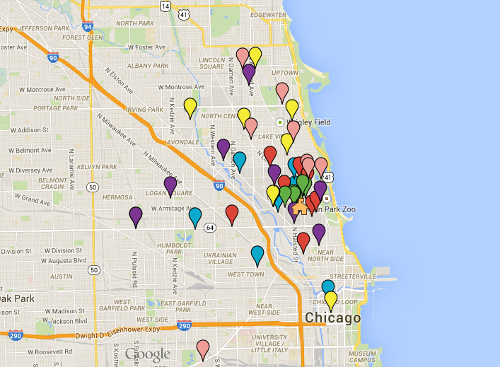
Community Mapping
Emotional/Mental Health
Physical Health
After-School/Educational
Business & Industry
Religious/Spiritual
Legislative
Notes:
Joe to add location, hours & cost (if applicable) to schools.

Slide 14
Guiding Questions

Slide 15
Site Visit
What are you proud of at Lincoln Park High School?
  International Baccalaureate (IB) Program
    One counselor specifically for IB Program
  95% of students apply to college
  80% of students attend college
  Renowned music and performing arts programs
Notes:
What was made very clear the day of our visit was the emphasis on IB students, they have a counselor specifically for these students. 95% of their students apply to college and 80% attend which is very high and their school has a large focus on Academics.
A question that came to mind for us was, “ Is there a lot of pressure for Freshman students to do well academically, due to the quick jump to a rigorous high school course load?”
We specifically focused on Freshman students, 634 of them. There is definitely a transitional culture shock the counselors explained, but most students stay enrolled.
We learned that the African American males are very generational because a lot of their parents, according to Mr. Baker, were not successful at the same school. We are curious to see if the students surveyed displaying less motivation came from parents that attended LPHS and either did not graduate or did not attend college.

Slide 16
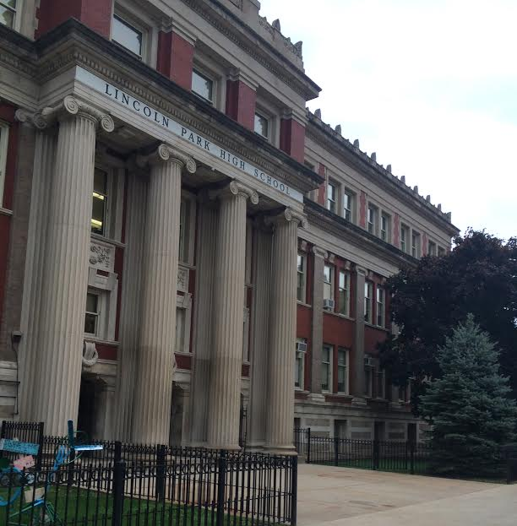
Site Visit
What kind of pressure do freshman students at Lincoln Park High School experience when transitioning to a new school?
Notes:
Upon learning about the level of academic rigor at LPHS (previous slide), we were interested to learn about the transition for freshman students coming from numerous neighborhoods with varying academic environments from elementary/middle schools around the Chicagoland area
Many experience a transitional culture shock but remain enrolled
Currently there are 634 Freshman students and one counselor
Students are not used to such freedoms within the open campus of Lincoln Park

Slide 17
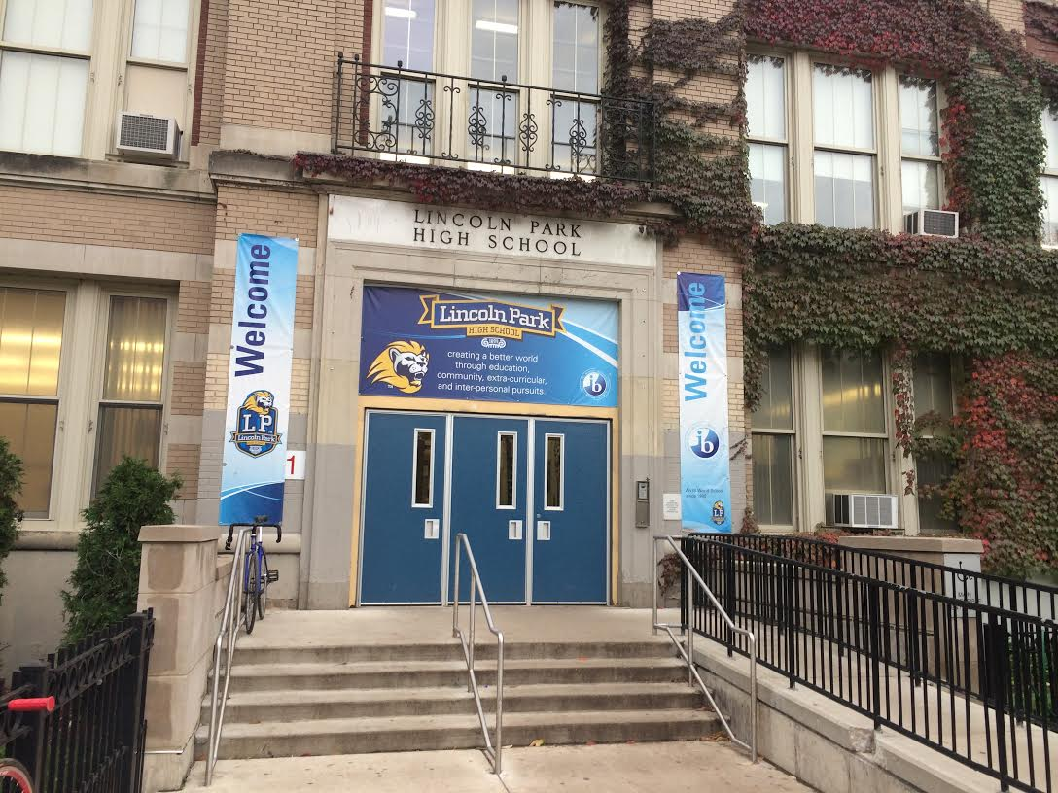
Site Visit
Are there currently any unaddressed needs?
Notes:
African American males display a lower level of success, according to freshman counselor
Generational influence of success or failure

Slide 18
Site Visit
What percentage of students reside in Lincoln Park? How does this factor influence your students?
  Students commute from various neighborhoods
  Resources must be accessible by public transportation

Slide 19
Needs Assessment

Slide 20
Development of Needs Assessment
Guided by the three American School Counselors Association (ASCA, 2004) domains:
  Academic
  Personal/Social
  College/Career
Review LPHS school counselor perceived need
Notes:
Counselor’s view of needs was the general transition needs of freshman with a focus on AA male population assuming there was a connection between neighborhood and parent’s education level.

Slide 21
Final Format
Qualtrics Survey
11 Questions
  6 multiple choice, 3 questions including a subset of 5-7 Likert scale questions
  2 open ended questions
Delivered electronically at individual counseling meeting with Chris Baker
Survey completed by 376 students
Notes:
There were 2 demographic questions. 3 Likert questions were guided by the 3 domains (academic, personal/social and college/career) as well as a focus on the student-counselor relationship.

Slide 22
Results

Slide 23
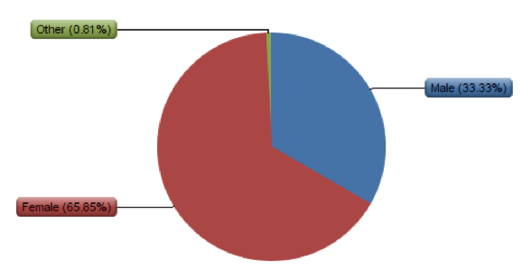
Sample Data
I identify as:
  65.85% Female
  33.33% Male
  0.81% Other
    Gender Fluid
    Gender Queer

Slide 24
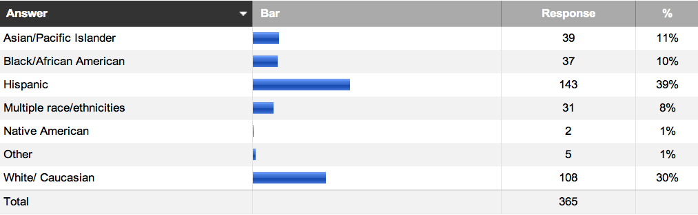
Sample Data
I identify with the following ethnicity:
  Other: White and Black, Spanish, Caucasian/African American, Black and Mexican, Black American

Slide 25
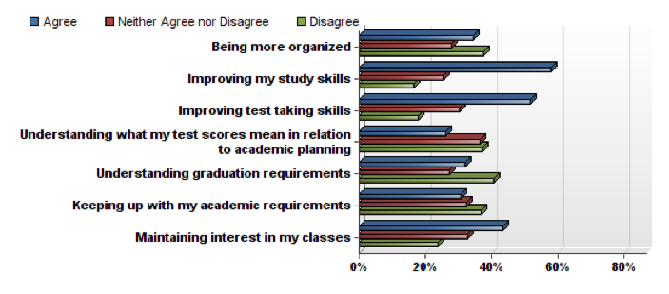
Domain: Academic/Career
I need help with the following SCHOOL concerns:
Notes:
Results –
Of the 376 freshman students who completed the survey,
35% need help with organization
58% need assistance with improving of study skills
52% need help improving their test taking skills
44% agree that they need help maintaining interest in their classes

Slide 26
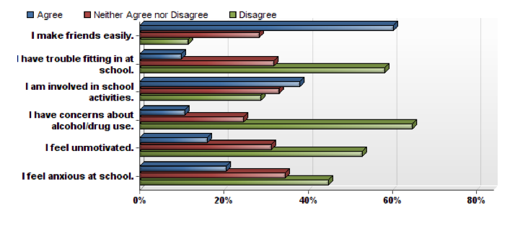
Domain: Personal/Social
Please answer the following PERSONAL statements:
Notes:
Results –
Based on the results, overall freshman students at LPHS don’t appear to have many personal/social concerns however we did find that:
16% feel unmotivated
21% feel anxious
11% have concerns about alcohol/drug use

Slide 27
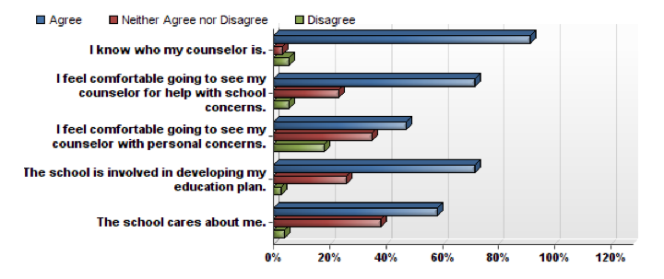
Student-School Counselor Relationship
Please answer the following statements:
Notes:
Almost 100% of students know who their school counselor with a majority feeling comfortable seeking help for school concerns, although only 47% feel comfortable discussing personal concerns.

Slide 28
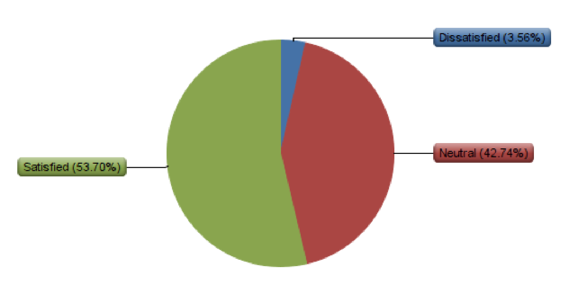
Student Satisfaction
Notes:
Michele & Amber to add student quotes – segway satisfaction to question #10 about improving experience

Slide 29
Next Steps…

Slide 30
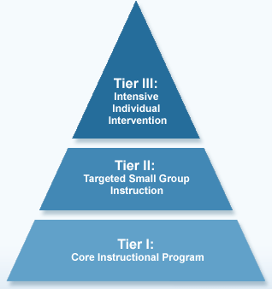
Next Steps…
Academic/Career
  Create classroom lessons focused on organization, study and test-taking skills
  Enhance teacher involvement with curriculum development
  Develop Senior/Freshman Mentor Program
  Partner with YMCA Achievers Program
Notes:
Given there is only 1 school counselor for 634 freshmen, we steered away from Tier 3 Response to Interventions and we focused mainly on tier 1& 2 RtI’s as a result of the data collected.
Academic/Career –
35% organization, 58% study skills, 52% test taking skills
44% maintaining interest in their classes
- Based on our data, there is a student need for help with organization, study and test-taking skills; therefore, we recommend the development of classroom lessons focused on these topics. Tier 2 RtI (Response to Intervention) level working in smaller groups.
Another data point we want to address is 44% of students have trouble maintaining interest in the classroom – we recommend pushing through a policy focused on curriculum building as part of teachers’ continuing education– help re-engage students and maintain interest in the classroom
Senior/freshman mentor program – share strategies for academic and career needs; time-management; teacher/study skill advice; seniors benefit through getting volunteer hours
YMCA Achievers program –7th- 12th graders are paired with adult mentor volunteers with the goal of exploring higher education & career options; career workshops hosted at DePaul University’s loop campus every Saturday. In these workshops, teens have the opportunity to learn more about careers in areas such as business/finance, communications, law and government, education, health sciences, and vocational and military fields. Youth also explore issues related to goal setting, self-esteem, resume writing, drug and alcohol awareness, conflict resolution, effective communication, and more! In addition, program participants partake in bi-annual worksite visits and annual college tours and job shadow days.

Slide 31
Next Steps…
Personal/Social
  Establish an interpersonal counseling group
  Partner with Boys & Girls Club Big Brothers/Big Sisters Mentoring Program
Notes:
Given there is only 1 school counselor for 634 freshmen, we steered away from Tier 3 Response to Interventions and we focused mainly on tier 1& 2 RtI’s as a result of the data collected.
Personal/Social –
16% feel unmotivated, 21% anxious, 11% have concerns about alcohol/drug use
RtI Tier 2 intervention: interpersonal counseling group addressing topics such as motivation, anxiety and alcohol/drug use
Boys & Girls Club: community resource has a partnership with Big Brothers/Big Sisters organization that pairs members with adult mentors who meet once a week at the Club with the purpose of providing moral support, encouragement and guidance to these teens. SMART Moves program helps young people positively handle the peer pressure of substance abuse or premature sexual involvement. The program uses discussion & role playing to develop assertiveness, resistance and refusal skills and positive outcomes. --- great opportunity for partnership through referrals or hosting a seminar where a rep from Boys & Girls visits LPHS to talk more about the program.

Slide 32
Next Steps…
Student-School Counselor Relationship
  Improve school wide awareness on the school counselor’s role
Notes:
Given there is only 1 school counselor for 634 freshmen, we steered away from Tier 3 Response to Interventions and we focused mainly on tier 1& 2 RtI’s as a result of the data collected.
Student-School Counselor Relationship
Results showed majority of students feel comfortable seeking help for school concerns, although only 47% feel comfortable discussing personal concerns.
Chris’ office is in the halls…it’s his counseling style…probably has to be because he has so many students…however, this setting might not be conducive for discussing personal/social concerns…advocate for spaces or rooms that Chris can reserve for more personal conversations
Tier 1 RtI intervention through school wide seminars – create more awareness among students, faculty and staff that school counselors are available to do so much more than academics – extending to the personal/social space.

Slide 33
Next Steps…
Plans for the next phase of research:
  Review data and results with Chris and Jessica and share proposed intervention strategies
  Explore current strategies and programs in place related to three ASCA domains
  Research current school community’s perspective on school counselor’s role and explore ways to strengthen collaboration and partnership
Notes:
Review our assessment results with Chris and Jessica and present proposed intervention strategies
Explore current strategies and programs in place for each of the 3 ASCA domains, in particular focusing on issues that came up in the needs assessment
Next phase of research: examine perspective of school counselor’s role in the community among students, faculty, staff, parents and other community members with the goal being to improve collaboration and the counselors’ impact at LPHS

Slide 34

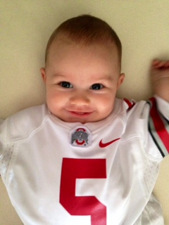
Go Buckeyes!

Slide 35
School counselors can change the world!

Slide 36
Works Cited
Illinois Report Card
  https://illinoisreportcard.com/District.aspx?DistrictID=15016299025
  http://illinoisreportcard.com/School.aspx?schoolID=150162990250047
  http://illinoisreportcard.com/School.aspx?source=StudentCharacteristics&source2=StudentDemographics&Schoolid=150162990250047
  http://illinoisreportcard.com/School.aspx?source=StudentCharacteristics&source2=LowIncome&Schoolid=150162990250047
  http://illinoisreportcard.com/school.aspx?source=Trends&source2=Status&Schoolid=150162990250047
CPS School Report
  http://schoolreports.cps.edu/CIWP_2012/SchoolID609738_HSCIWP_as_of_112212.pdf
RtI Image
  http://teacher.scholastic.com/products/sri_reading_assessment/RTI_Alignment.htm
Notes:
LPHS Website
ASCA book
IL Report Card
ISBE Goals

